Slide 1

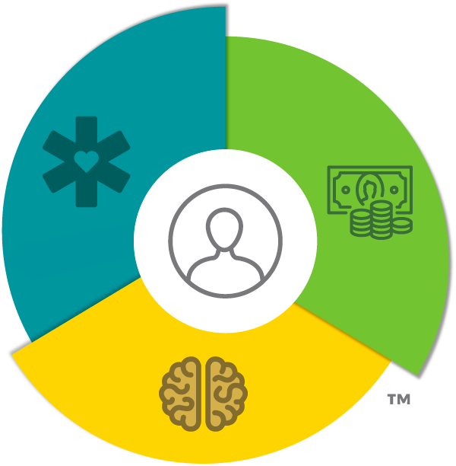
Patient-centered Methodology
for product development
Notes:
Bill Gates quote

Slide 2
2/3 of launches fail to meet pre-launch expectations*
* McKinsey analysis, Beyond the Storm, Launch Excellence in the New Normal
Declining returns on marketing investments
Declining access to customers

Slide 3
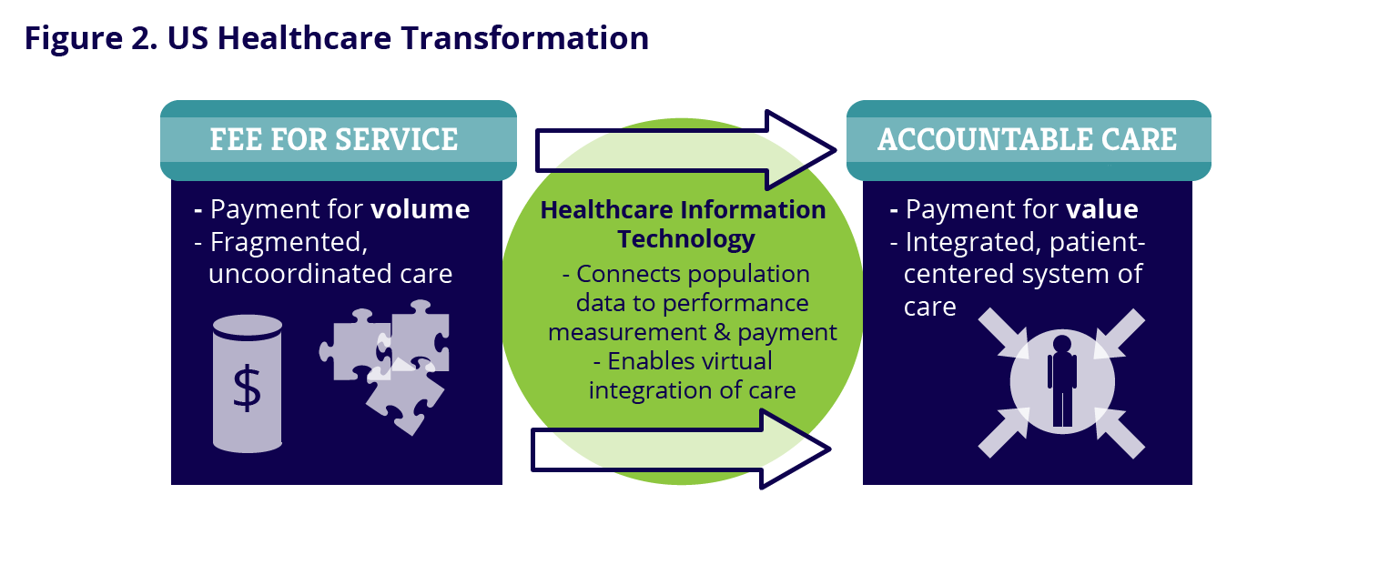
Rapidly Changing US Market
Healthcare delivery and payment Transformations
Patient-Centered and Value-Based

Slide 4
Patient-Centered Healthcare
A definition
Patient-centered healthcare occurs when…
… patients and physicians are jointly accountable for making educated decisions (shared-decision making)
….that marry a physician’s understanding of the most relevant clinical evidence
….with a patient’s values, beliefs, and preferences

Slide 5
Patient-Centered, Value-Based Market
Critical to understand All influences on rx utilization and outcomes
Integrated Delivery Networks
Hospitals
Group Practices
ACOs
Government
Employers
Payers
Health Plans
VALUE-BASED
PAYMENT
Providers
HCPs
CARE COORDINATION
SHARED DECISION
MAKING
OOP COSTS
CO-PAYS
Patient
Willingness to pay and adhere to treatment
Real world outcomes

Slide 6
Implications for Pharmaceutical Industry
Healthcare delivery and payment Transformations
Disease focus
Well-defined populations
Paid for pills/volume discounts
At risk for real world outcomes
“Push” model to payers, providers, physicians
Alignment, co-development and collaboration with customers

Slide 7



Key Insights Often Lag…
Product development
Clinical
Insights
Healthcare Professionals
Organized
Providers
Market Access
Insights
Payers
Patient
Attitudinal & Behavioral Insights
Patient

Slide 8

Strategies & Resources Deployed in Silos…
Go to market resources
Account Execs
Medical
Outcomes Research
Health Plans
IDNs
ACOs
Hospitals
Medical Groups
Administration & Leadership
Medical
Detailing Representatives
Specialists
Primary Care
NPs/PAs/Staff
Healthcare Professionals
DTC
Patient Type 1
Patient Type 2
Patient

Slide 9
…to an Increasingly Integrated, Connected Customer
Consolidation and integration among organized customers
Account Execs
Medical
Outcomes Research
Administration & Leadership
Medical
Detailing Representatives
CONNECTED VIA ELECTRONIC MEDICAL RECORDS
Physicians
DTC
Patients

Slide 10

…Measured on Triple Aim Results
The triple aim
Improve Health Outcomes
Reduce Per Capita Costs
Improve
Patient Experience

Slide 11
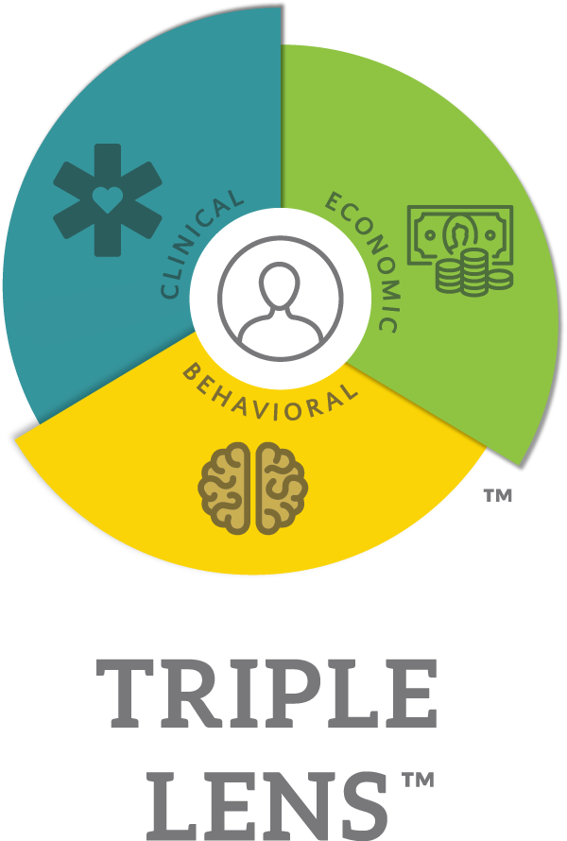
From Disease Focus to
Well-defined Patient Population
Fully characterizes patient population
Clinically: Disease severity, progression, concomitant conditions and full spectrum of treatments
Economically: Utilization of healthcare services; OOP costs to patient
Behaviorally: Understand patient experience with disease and healthcare system and the resultant behaviors
Aligns with customers’ perspectives and goals:
US healthcare system’s Triple Aim Objectives
Healthcare professionals’ patient type perspective
Payers’ and providers’ population health perspective
Helps articulate clear value propositions to customers

Slide 12

Illuminates Behaviors and Risks for Real World Outcomes
fully characterizes patient experience
Patient experiences symptoms
At annual checkup, Patient minimizes symptoms
due to fear and embarrassment
Misdiagnosis of symptoms due to Patient’s downplay
Patient requires hospitalization

Slide 13
Inform Product Development
Informed strategic choice
Triple LensTM
Inform
Patient Analysis and Patient Journey Analysis
Value-based payment analysis
Payers’ and providers perspective on patient
Doctor-patient interaction
Patient willingness to pay
Studies: Well-defined Patient Types and Triple Aim benefits
Design of services and tools
Value Propositions: Pricing/Contracting strategies
Market development areas
Brand Development

Slide 14
Informed Strategic Choice
Insights should inform product development decisions
Triple LensTM
Inform
Value-Based Payment Analysis
Doctor-Patient Interaction
Willingness to Pay
Patient Analysis and Patient Journey Analysis
Studies: Well-defined Patient Types and Triple Aim benefits
Design of Services
Value Propositions: Pricing/Contracting/Co-Pays
Brand Development

Slide 15
Triple LensTM
insights informs critical launch Decisions
Insights
Inform
Value-Based Payment Analysis
Doctor-Patient Interaction
Willingness to Pay
Triple LensTM Patient Analysis
Studies: Well-defined patient types and Triple Aim benefits
Design of services
Brand Development
Organized Customer Insights
Local Market Analysis to understand key similarities and differences
Patient-Centered Narrative and Message Development
Relevant Menu of Tools and Services
US Launch Strategy
Customer Prioritization and Identification of Collaboration Opportunities
Account and Customer Planning
Customer Plans of Action

Slide 16
Triple LensTM
informING strategic choiceS throughout product development and launch
Brand Development
US Launch Strategy
Identify key barriers for focused market development investment
Customer Plans of Action
Prioritize customers and define areas of collaboration with payers and providers to achieve real world outcomes and reduce areas of financial risk
Create a competitive product value proposition that is deeply rooted in the needs, behaviors, journey, and value-based outcomes of the end customer—the patient.
Develop high-impact customer engagement platforms, communicating in language that aligns with the priorities and capabilities of organized customers including health plans, IDNs, ACOs, and physician groups.

